Slide 1


ELEN E6893 Big Data Analytics
Research Project Proposal: Spotify Classifier
Alex Thornton, Elmira Aliyeva, Tanvi Pande
Date Performed: November 5, 2021

Slide 2

Project Overview
Seek to design and implement model for unsupervised music genre classification
10,000+ songs will be sourced and processed from Spotify to perform k-means clustering
End product will be able to accept preprocessed song metadata, vectorize, and classify by genre
Fig 1. Spotify - source for song metadata

Slide 3
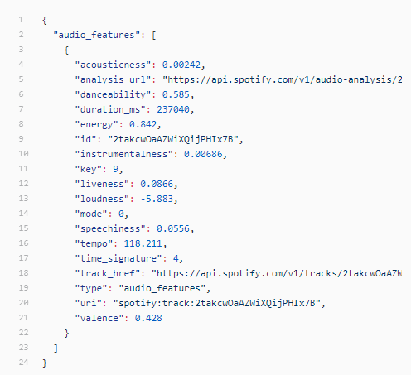
Data V's
Volume
10,000+ songs will be processed
Variety
All song metadata structured in json format
Velocity
Data not time sensitive/ streamed
Spotify queried for song metadata in batches by genre
Fig 2. Song metadata

Slide 4
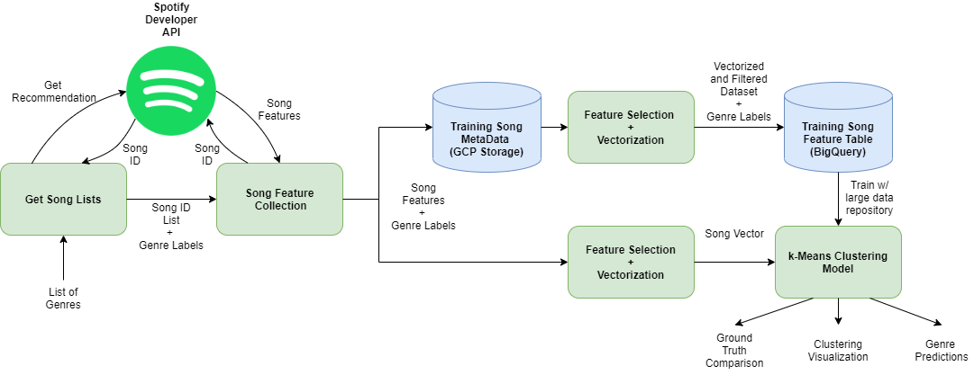
Model Architecture
Fig 2. System Diagram

Slide 5



Methods (Tools + Algorithms)
Spotify Developer API
Source song metadata / features
Find songs from recommendations by genre
Google Cloud Platform
Run jobs to train model with Dataproc
Store processed song data with BigQuery
Spark ML Library
Use built in spark tools (MapReduce, k-means) for model pipeline
GitHub
Shared repository for collaboration among teammates
https://github.com/athornton1618/SpotifyClassifier
Fig 3. Tools (GCP, GitHub, Spark)

Slide 6
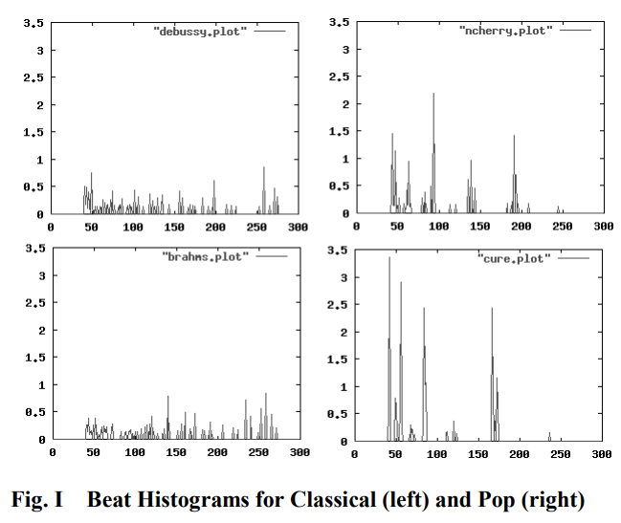
Reference Material
[1] Automatic Musical Genre Classification Of Audio Signals - Princeton CS dept
Princeton research focused on DSP of raw audio
Spotify won't provide audio mp3's, only preprocessed metadata with features
Our project will scale for much larger song datasets
Fig 4. Beat Histogram for Classical (Left) and Pop (Right) [1]

Slide 7
Schedule
11/05 | Proposal Presentation (Today) | Everyone
11/14 | Initial Progress Checkpoint (API keys, sample song metadata json stored in dataproc) | Alex
11/19 | Progress Presentation | Everyone
11/28 | Minimum Viable Product (product owners listed) Data collection Song vectorization + processing K-means model Analysis + Visualization | Alex Tanvi Elmira Everyone
12/03 | Progress Report | Everyone
12/05 | Completion of all scripts, model trained, verification | Everyone
12/17 | Final Slides Submission | Everyone

